Slide 1

AFNT Project Ali Suhail | 21072712

Slide 2
Project Aim
To design and implement a software solution focused on helping users achieve their fitness objectives.
This involves developing a user-friendly platform for creating and customising workout routines, monitoring nutrition and workout progress, and offering health and fitness guidance.
The main aim is to build an engaging and efficient fitness tool that encourages users to live healthier, more active lives.

Slide 3
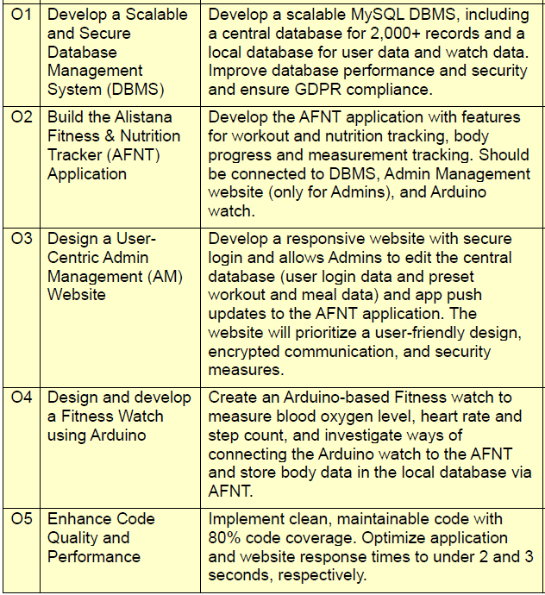
PROJECT OBJECTIVES

Slide 4
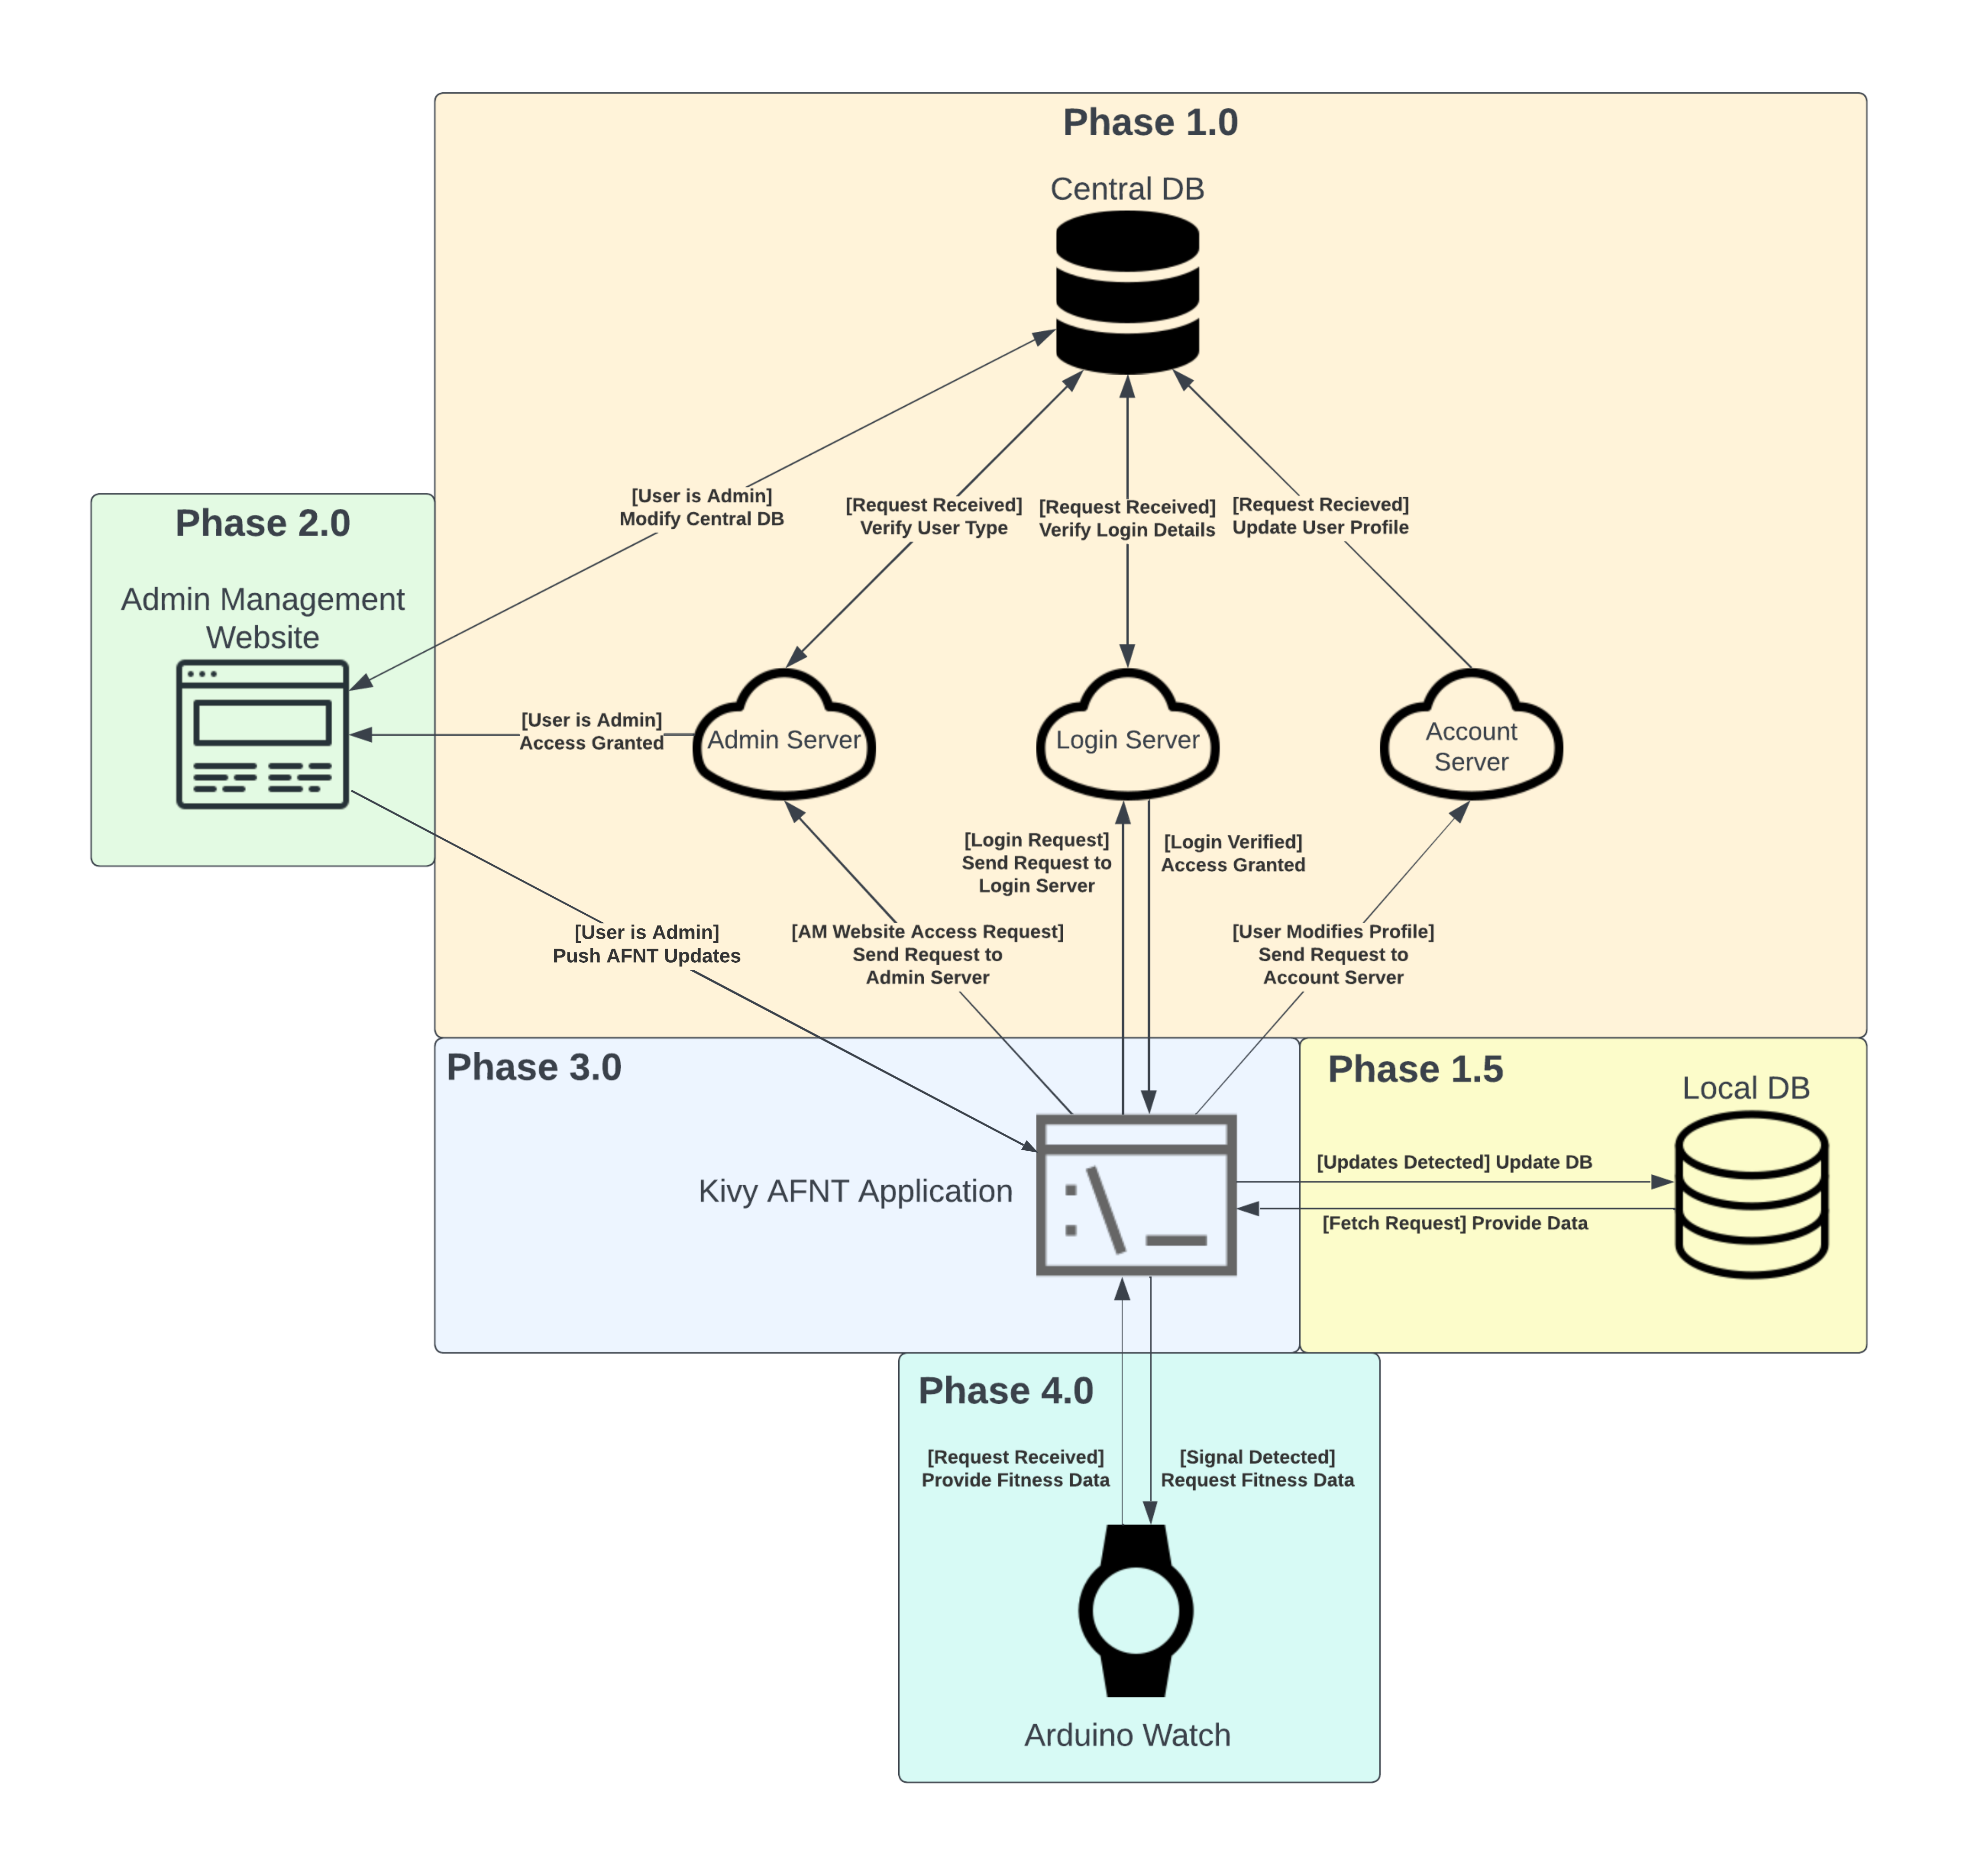
Agenda
Phase 1: DBMS
Phase 2: AW Website
Phase 3: AFNT Application
Phase 4: Arduino Watch

Slide 5

Phase 1: DBMs

Slide 6

Central database (cdb)
Managed by Admins and responsible for managing:
Preset workouts and exercises.
Preset meals and food items.
User details.
CentralDB updates to AFNT App.

Slide 7
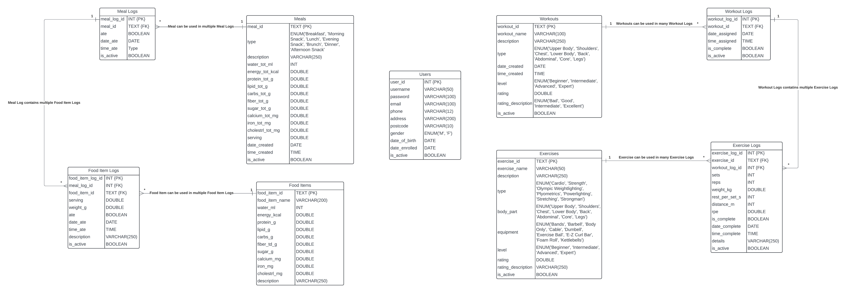
Central database schema

Slide 8

Local database (ldb)
Managed by AFNT users and responsible for managing:
Custom workouts and exercises.
Custom meals and food items.
Use preset workouts and meals.
Log body data (steps, weight, etc).
User details.

Slide 9
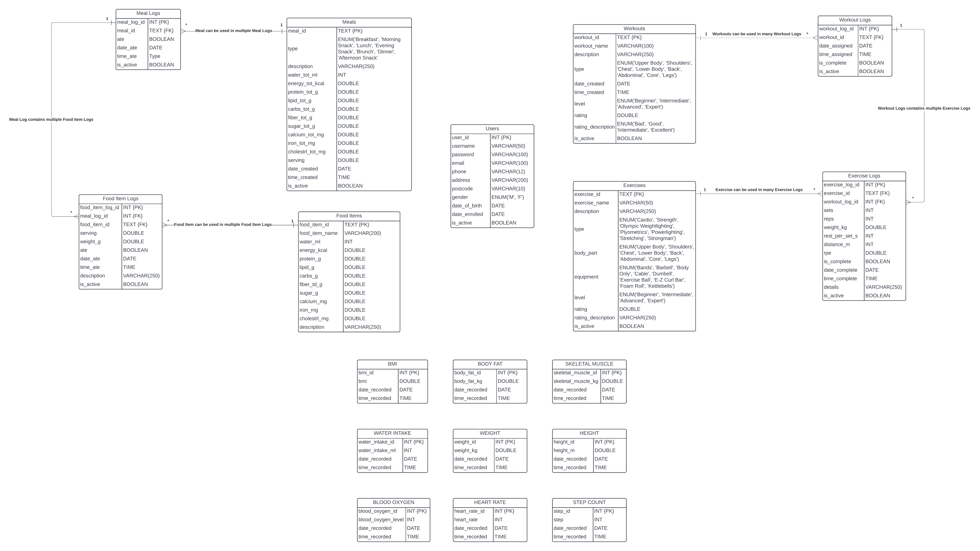
Local database schema

Slide 10

Phase 2: am website

Slide 11
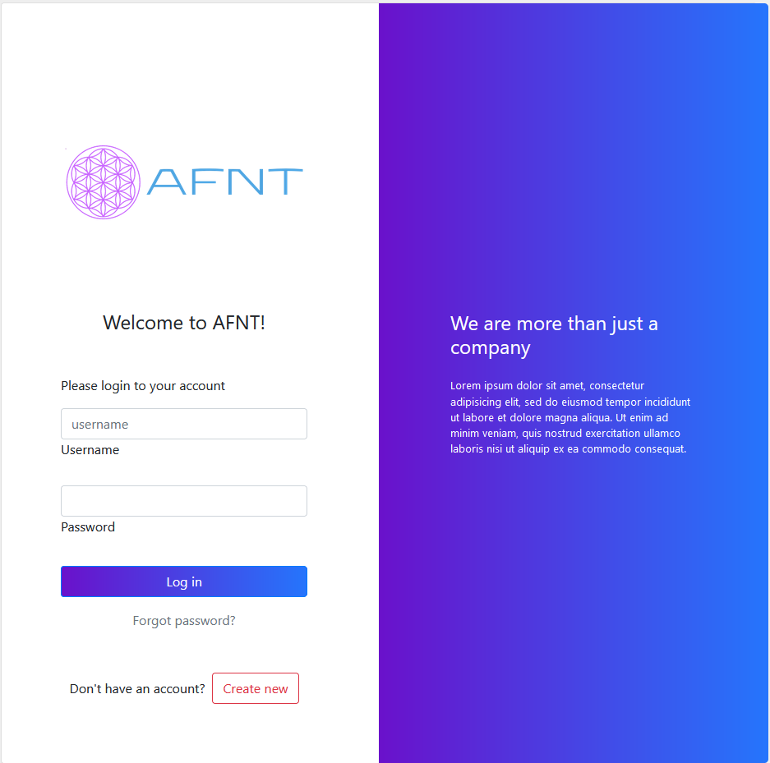
Admin management website (aw website)
Website for Admins and manages:
Preset workouts and exercises.
Preset meals and food items.
User details.
CentralDB updates to AFNT App.

Slide 12

Phase 3: AFNT App

Slide 13
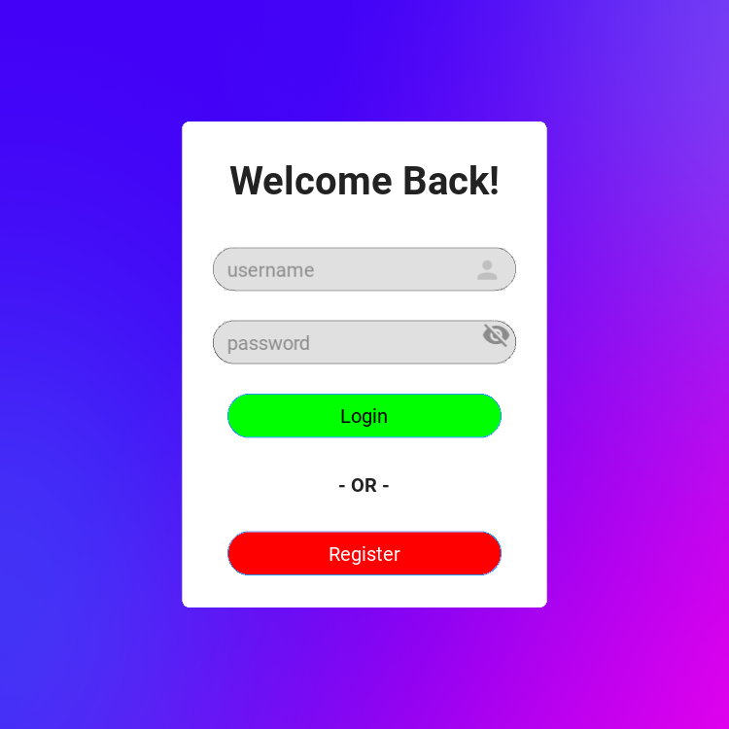
Afnt application
Cross-platform app for users, and allows users to:
Manage workouts and exercises.
Manage meals and food items.
Locate closest gyms/fitness centres.
Log body data.
Log meal and water intake data.
Generate plots for body and meal data.
Link with the Arduino Watch (Phase 4).

Slide 14
Phase 4: Arduino Watch

Slide 15
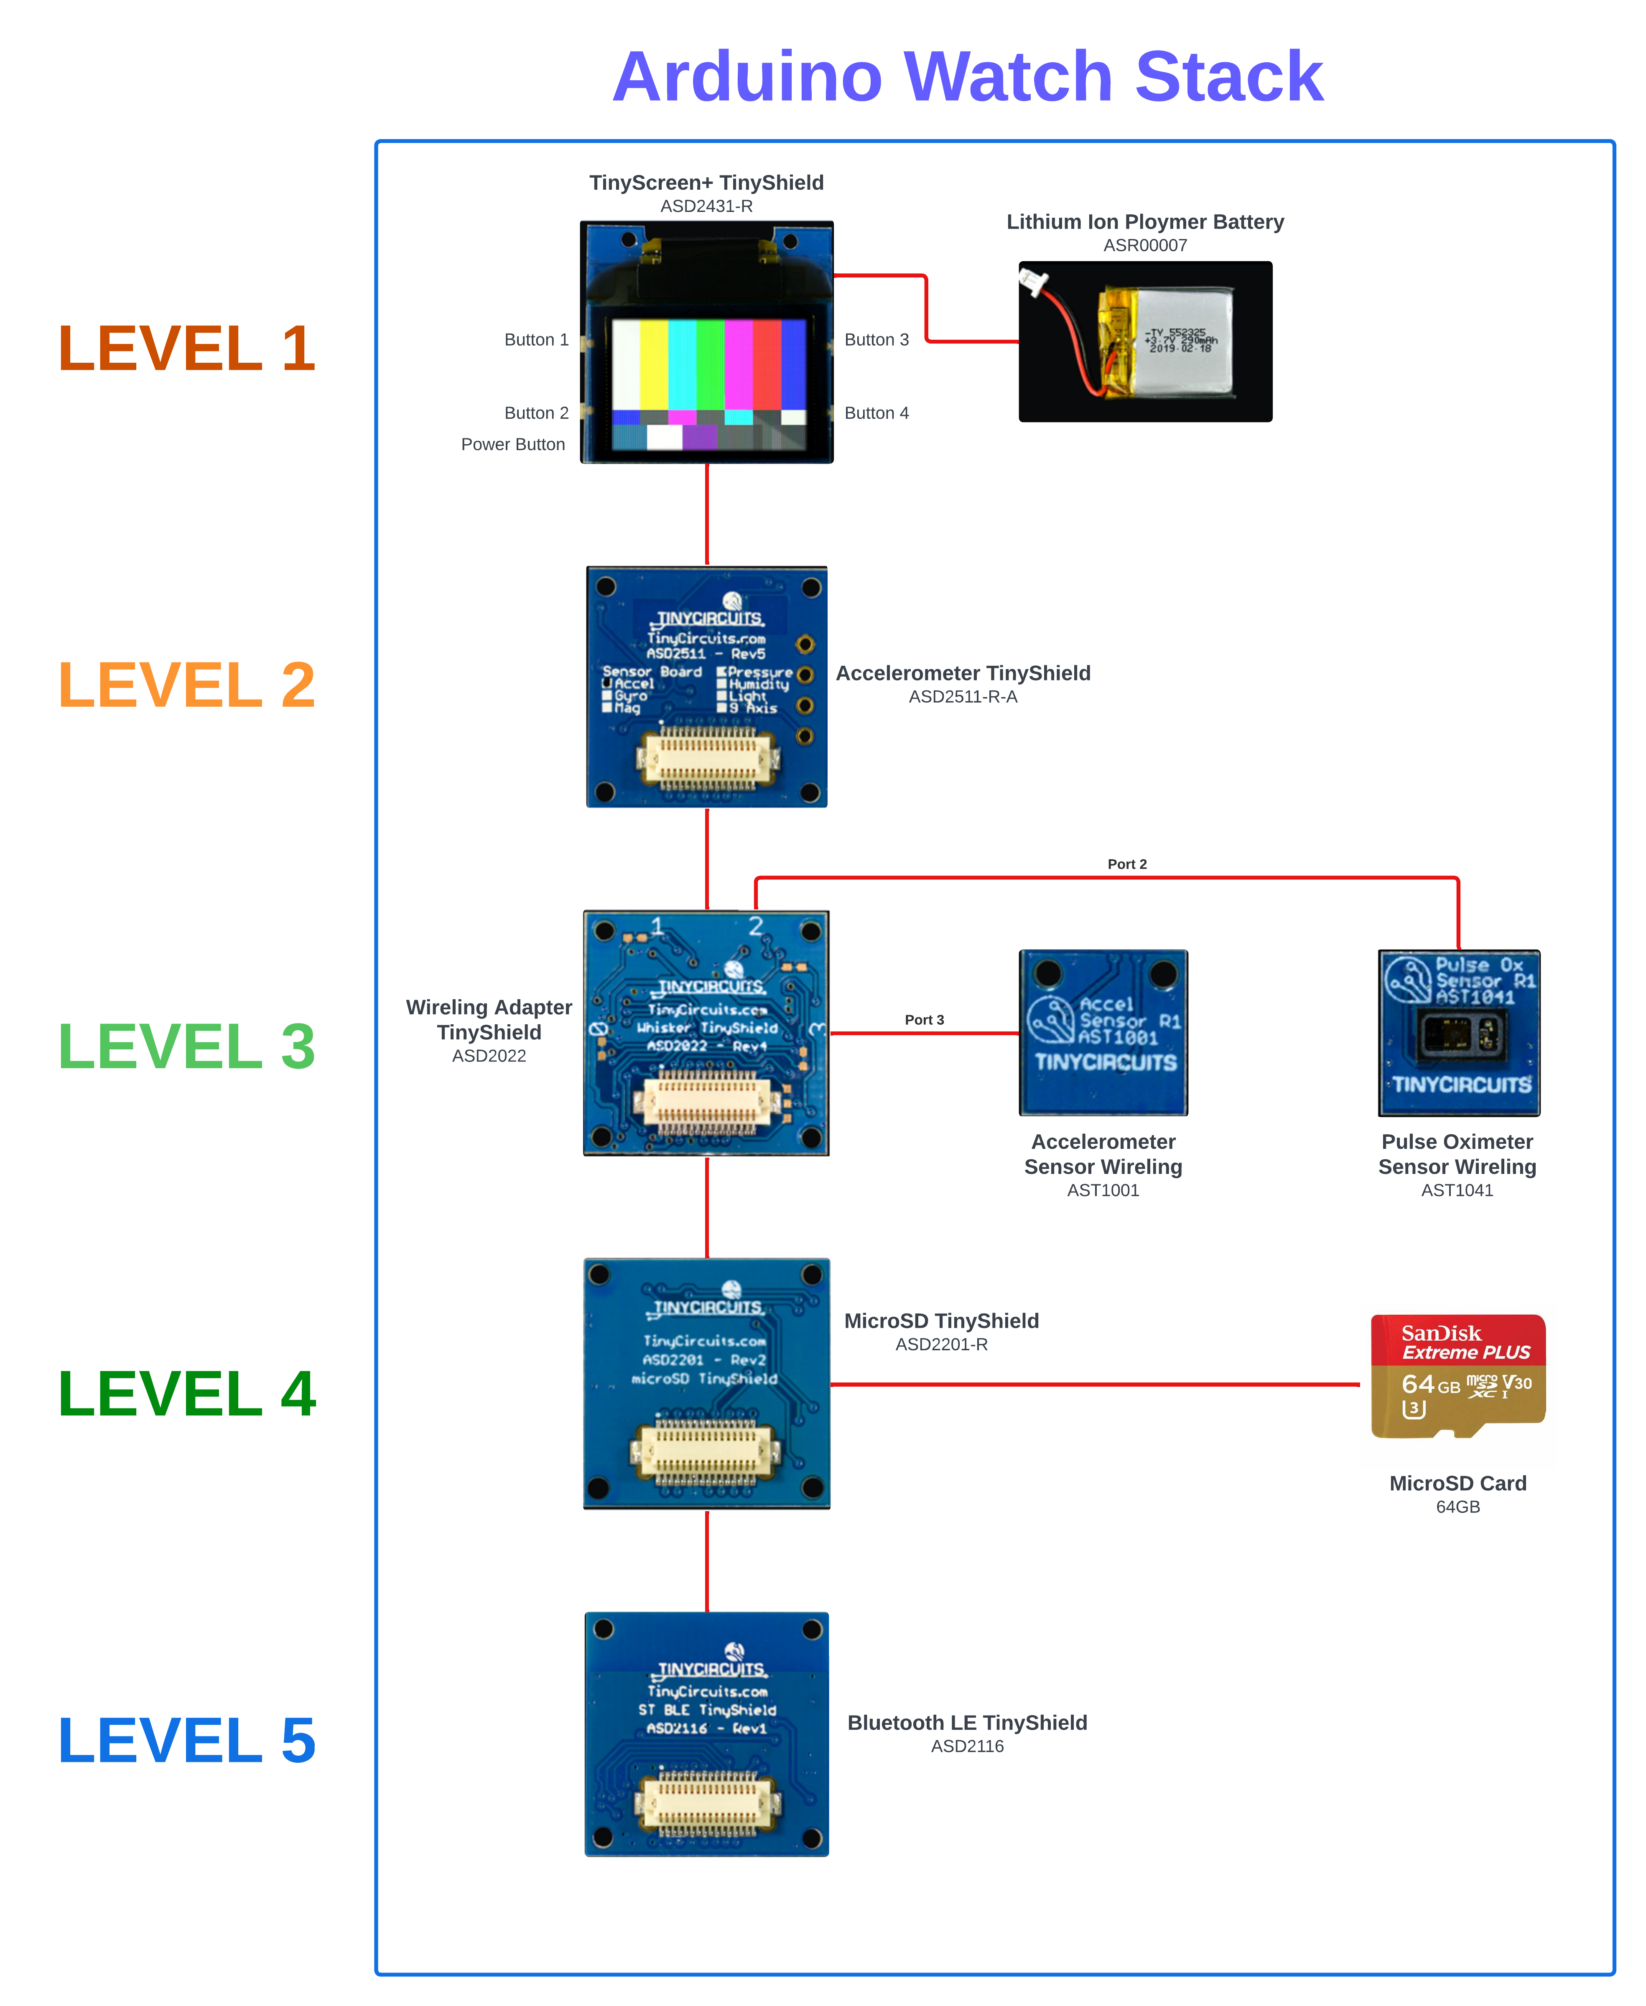
ARDUINO WATCH
Uses TinyCircuit’s small modular components and allows users to:
Track steps and step goals.
Heart rate.
Blood oxygen level (saturation level).
Body temperature.
Logs data into CSV file.
Accessed by AFNT app via USB or Bluetooth Low Energy (BLE).

Slide 16
Current progress

Slide 17
Afnt project progress
Phase | Percentage Complete | Not Implementing | Not Started | Partially Complete | Complete
Phase 1 | 86% | 0 | 0 | 5 | 13
Phase 2 | 30% | 8 | 1 | 5 | 3
Phase 3 | 61% | 2 | 8 | 21 | 35
Phase 4 | 73% | 0 | 0 | 8 | 7

Slide 18

Thank you

